Slide 1
The Salmonid Population Viability Project Seth Wenger, UGA River Basin Center

Slide 2
The Salmonid Population Viability Project Team
Seth Wenger, UGA River Basin Center
Erin Landguth, University of Montana
Helen Neville, Dan Dauwalter, Robin Bjork and Kurt Fesenmyer, Trout Unlimited
Jason Dunham, Nate Chelgren, USGS
Dan Isaak, Charlie Luce & Zach Holden, USFS Rocky Mountain Research Station
Mary Peacock, University of Nevada-Reno
Joe Glassy, Lupine Logic, Inc.
Doug Peterson, US Fish & Wildlife Service

Slide 3
Partners / End Users
Trout Unlimited
US Fish and Wildlife Service
US Forest Service
Bureau of Land Management
Seattle City Light
Nevada Dept of Wildlife
California Dept of Fish and Wildlife
Utah Division of Wildlife Resources

Slide 4
The motivation: better conservation planning
Population-level assessment– how “healthy” is each population?
Taxon-level assessment– scaling up population-level data; incorporating representation, resiliency, redundancy.
Part of Trout Unlimited’s Conservation Success Index for Colorado cutthroat trout.

Slide 5
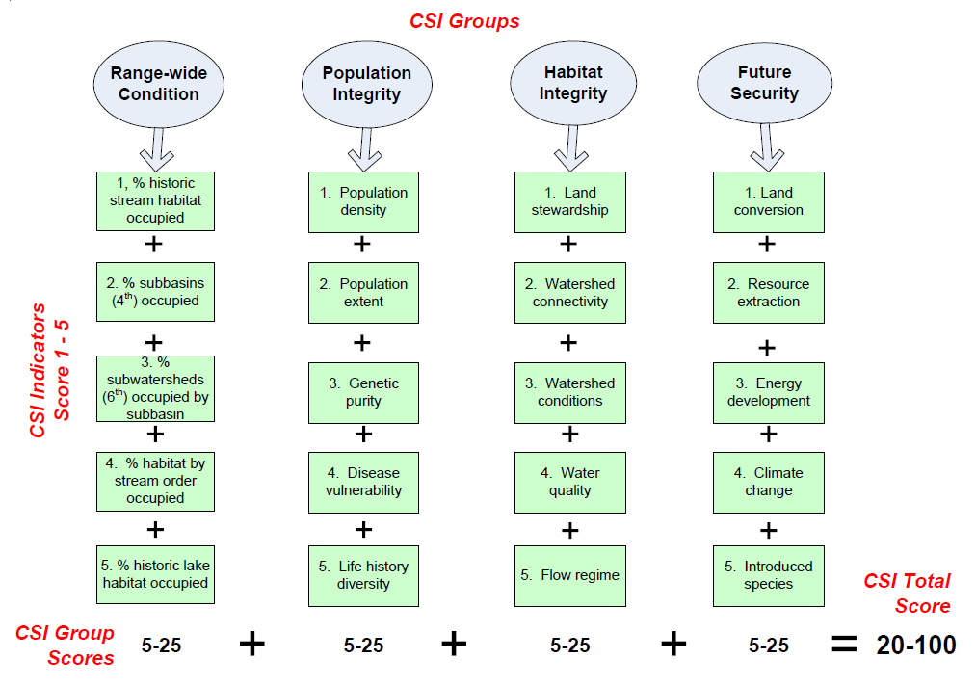
Trout Unlimited’s Conservation Success Index

Slide 6
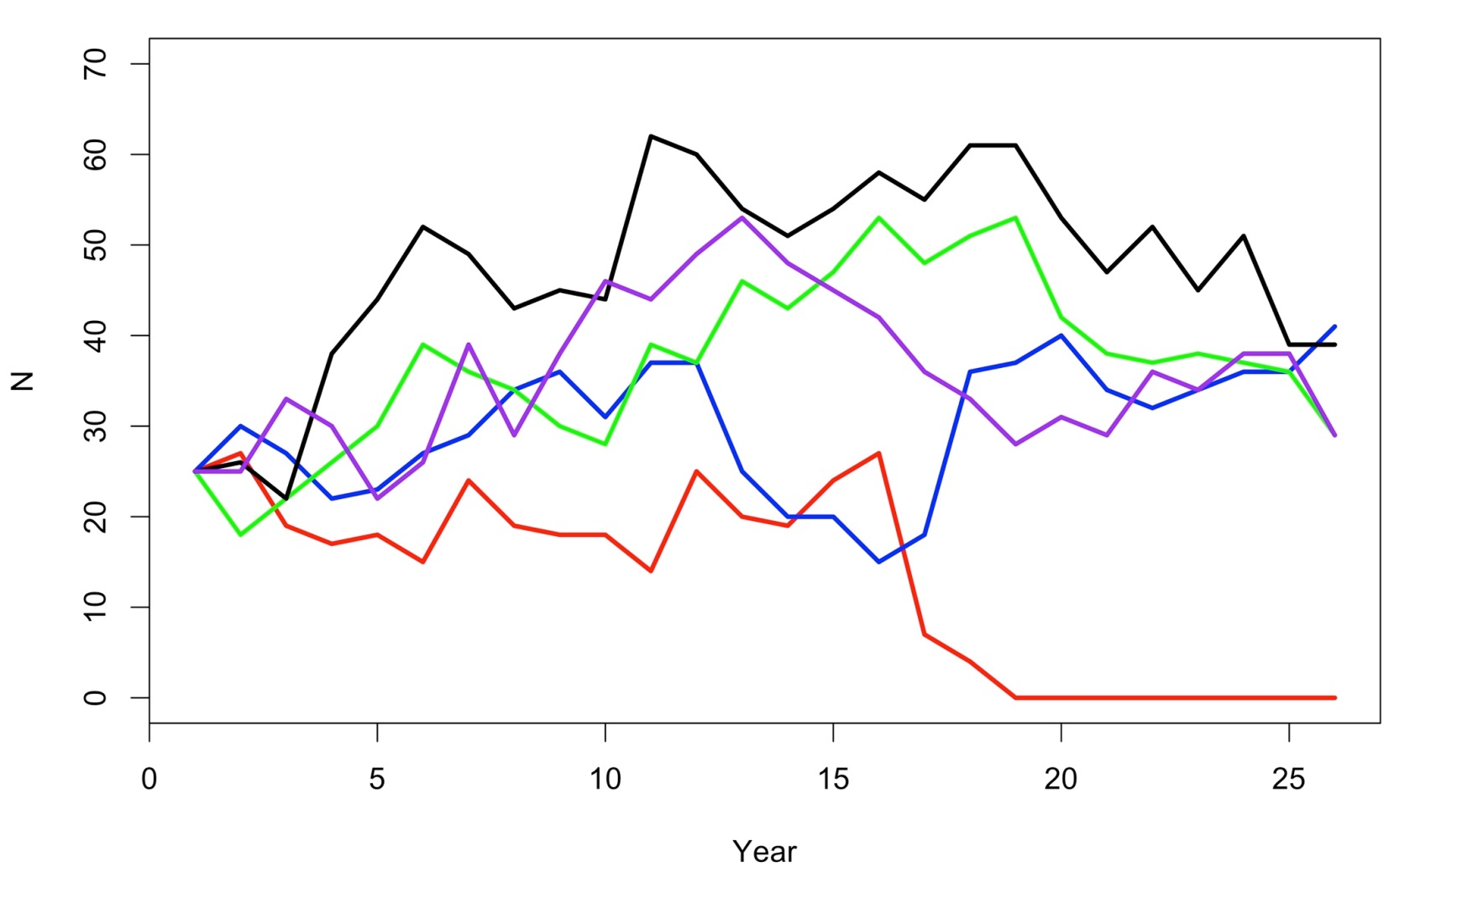
Population Viability Analysis

Slide 7
Why aren’t we using PVA more?
Data-intensive– 7-10 years of consecutive abundance estimates are the minimum for each population.
Each population is modeled separately. Limited options for extrapolation.
Alternative modeling approaches (e.g., RAMAS) require parameters that must be estimated from literature values– make limited use of field data.

Slide 8
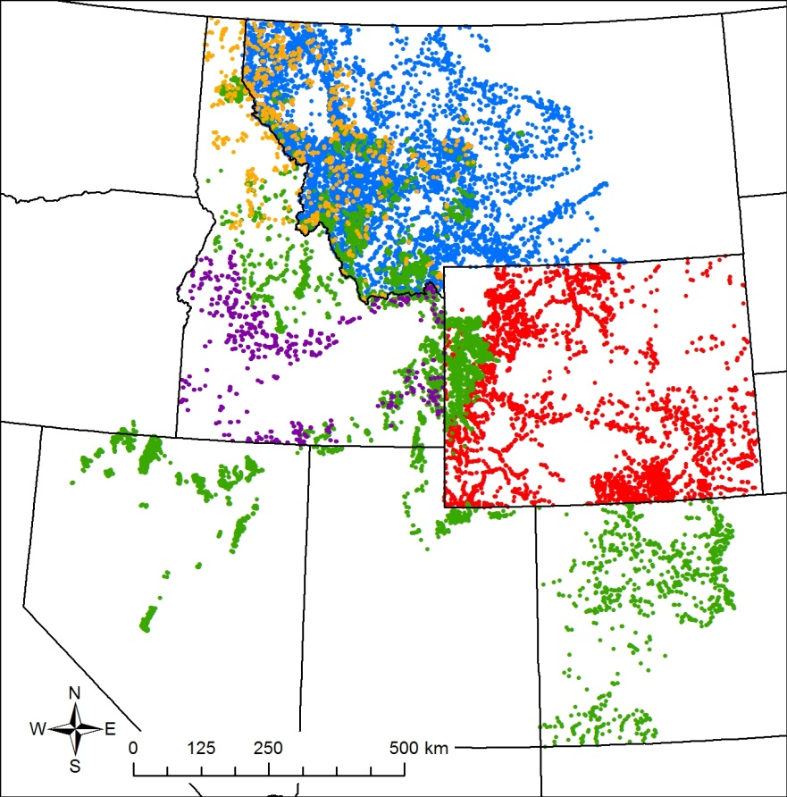
Lots of fish data exist
Some of the existing fish collection sites in the Rocky Mountain West. We are organizing subsets of these data as part of this project.

Slide 9
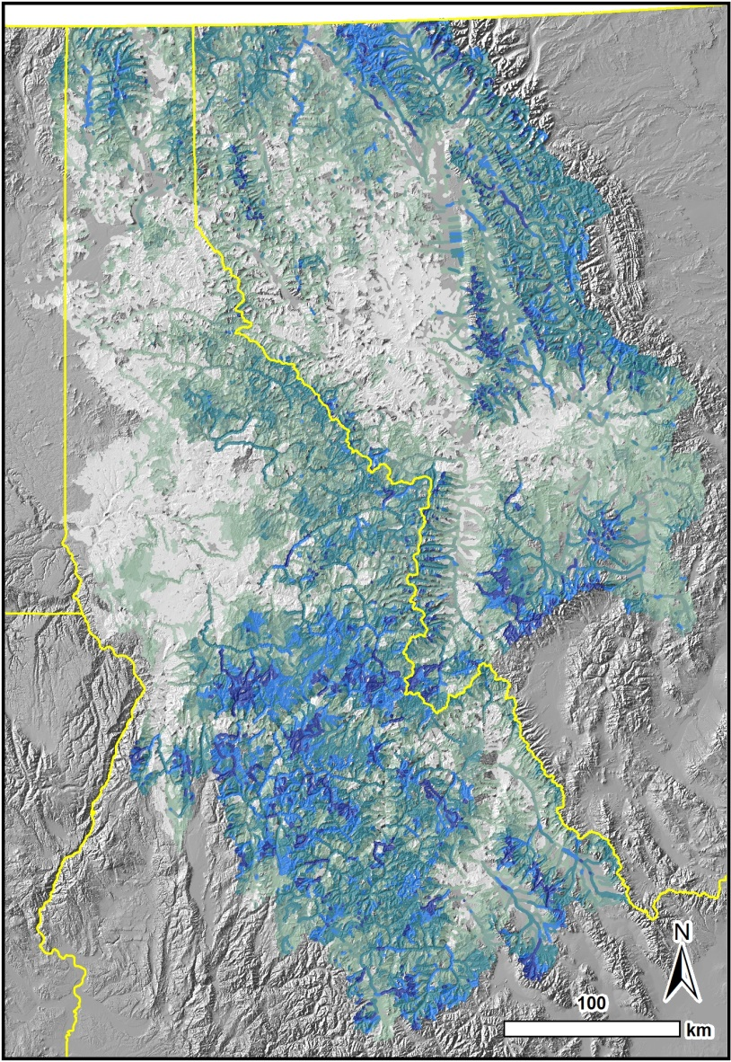
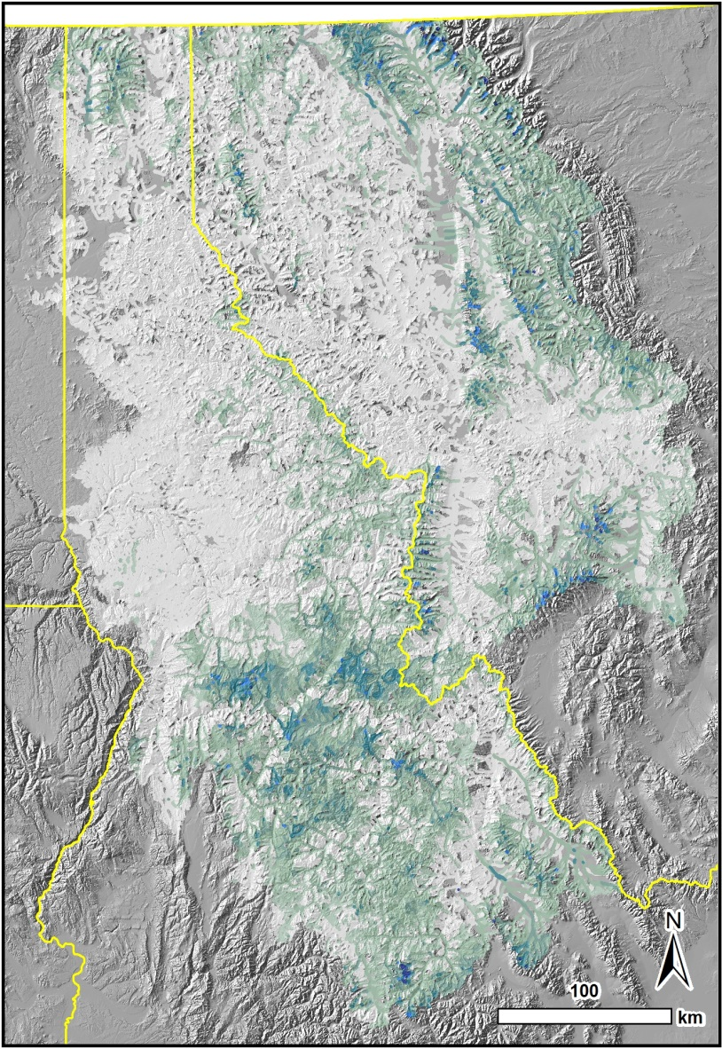
Alternatives: niche modeling

Slide 10
What we’re doing
Developing two new, complementary methods of population viability analysis.
Method 1: STPVM, a spatio-temporal statistical population viability model. Best suited to isolated populations.
Method 2: CDmetaPOP, an individual-based model that can predict both demographic and genetic viability. Best suited to connected populations (metapopulations).

Slide 11
STPVM- core model
Growth Rate
Environmental variability
Population Now (known)
Population Last Year (known)
Carrying Capacity
Carrying capacity varies in space– it’s habitat size and quality.
Environmental variability varies in space and time– it’s climate/weather related variables, like temperature and flow.
Notes:
A statistical model based on the classical density-dependent Ricker model, with three main parameters: carrying capacity, growth rate, and temporal variability.
Carrying capacity and growth rate are modeled as functions of spatial covariates that describe habitat size and quality. These are derived in part from remotely sensed data.
Temporal variability is modeled as a function of spatio-temporally fluctuating variables, such as temperature and flow. These are also derived in large part from remotely sensed data

Slide 12
STPVM, cont’d
Models are fit using actual observations of organisms.
Information is “borrowed” across many observations in space and time.
This allows us to make estimates in locations with limited or no data, with realistic uncertainties.
P1
P3
P2
P4

Slide 13
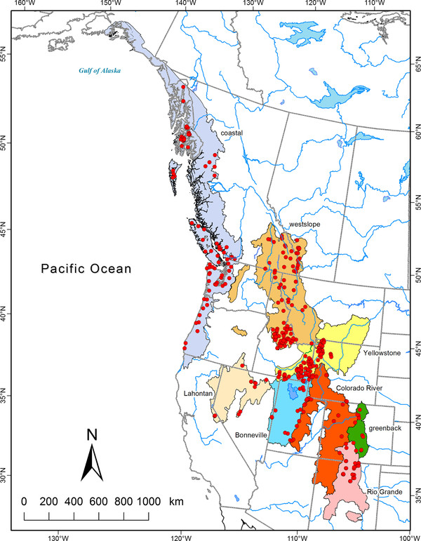
Pilot analysis: cutthroat trout

Slide 14
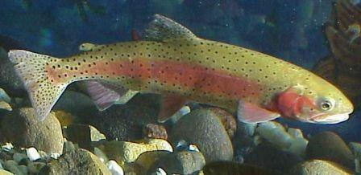
Pilot analysis: Lahontan cutthroat trout
Federally threatened under the ESA.
Exists mainly in isolated populations

Slide 15
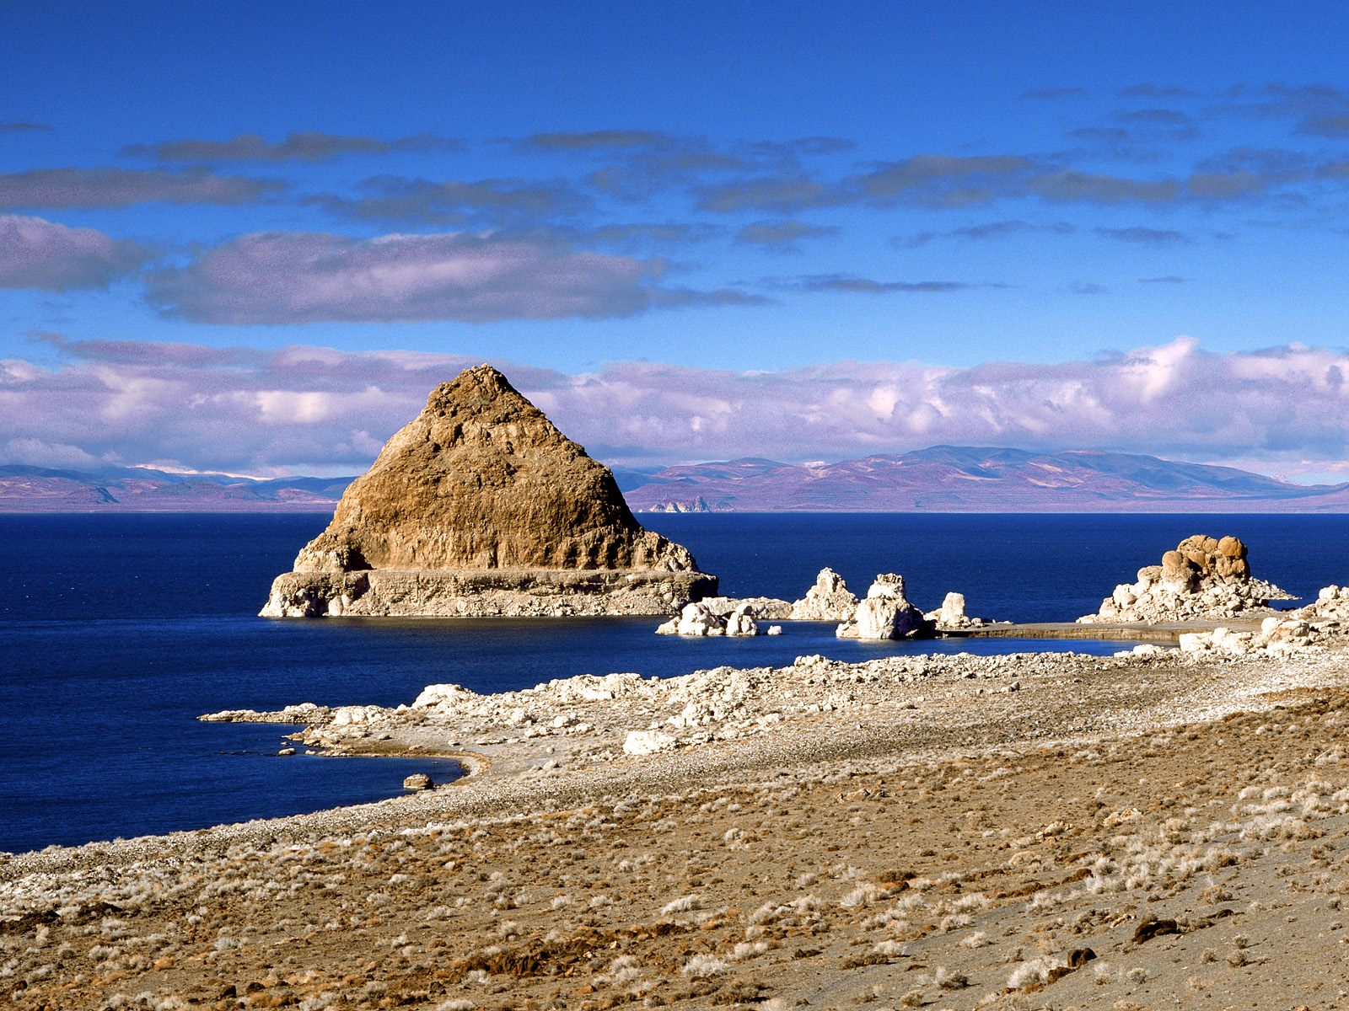
Side story: Pyramid Lake Lahontan cutthroat

Slide 16
Side story: Pyramid Lake Lahontan cutthroat
The “salmon trout” of Pyramid Lake
Up to 60 lbs (a giant rainbow trout is 30lbs)
Declared extinct in the 40s
Replaced with other Lahontan strains, but they never grew more than 10 lbs

Slide 17
Side story: Pyramid Lake Lahontan cutthroat
The “salmon trout” of Pyramid Lake
Up to 60 lbs (a giant rainbow trout is 30lbs)
Declared extinct in the 40s
Replaced with other Lahontan strains, but they never grew more than 10 lbs
The Lahontan strain was “rediscovered” in a small stream in Eastern Nevada

Slide 18
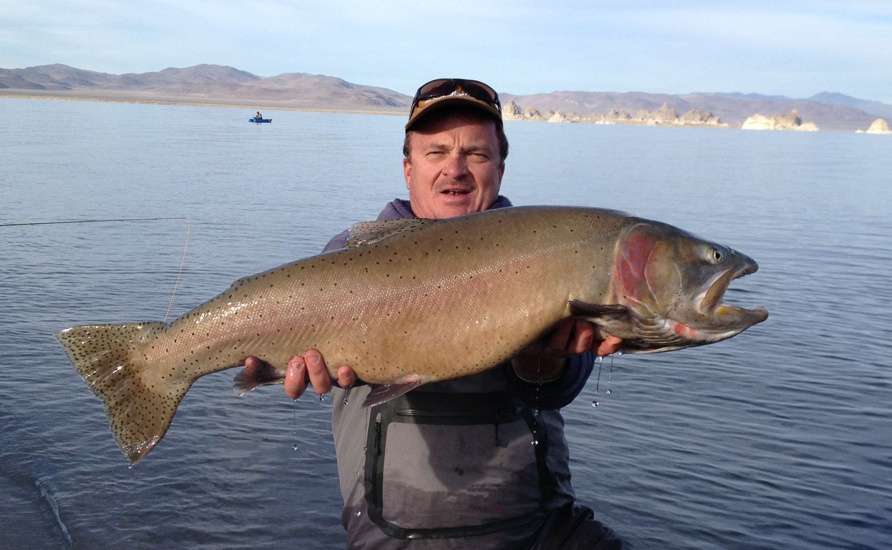

Slide 19
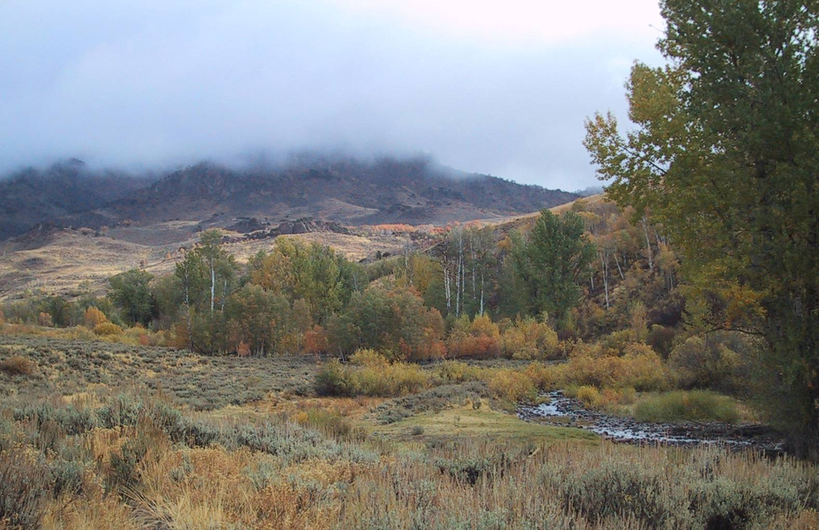

Slide 20
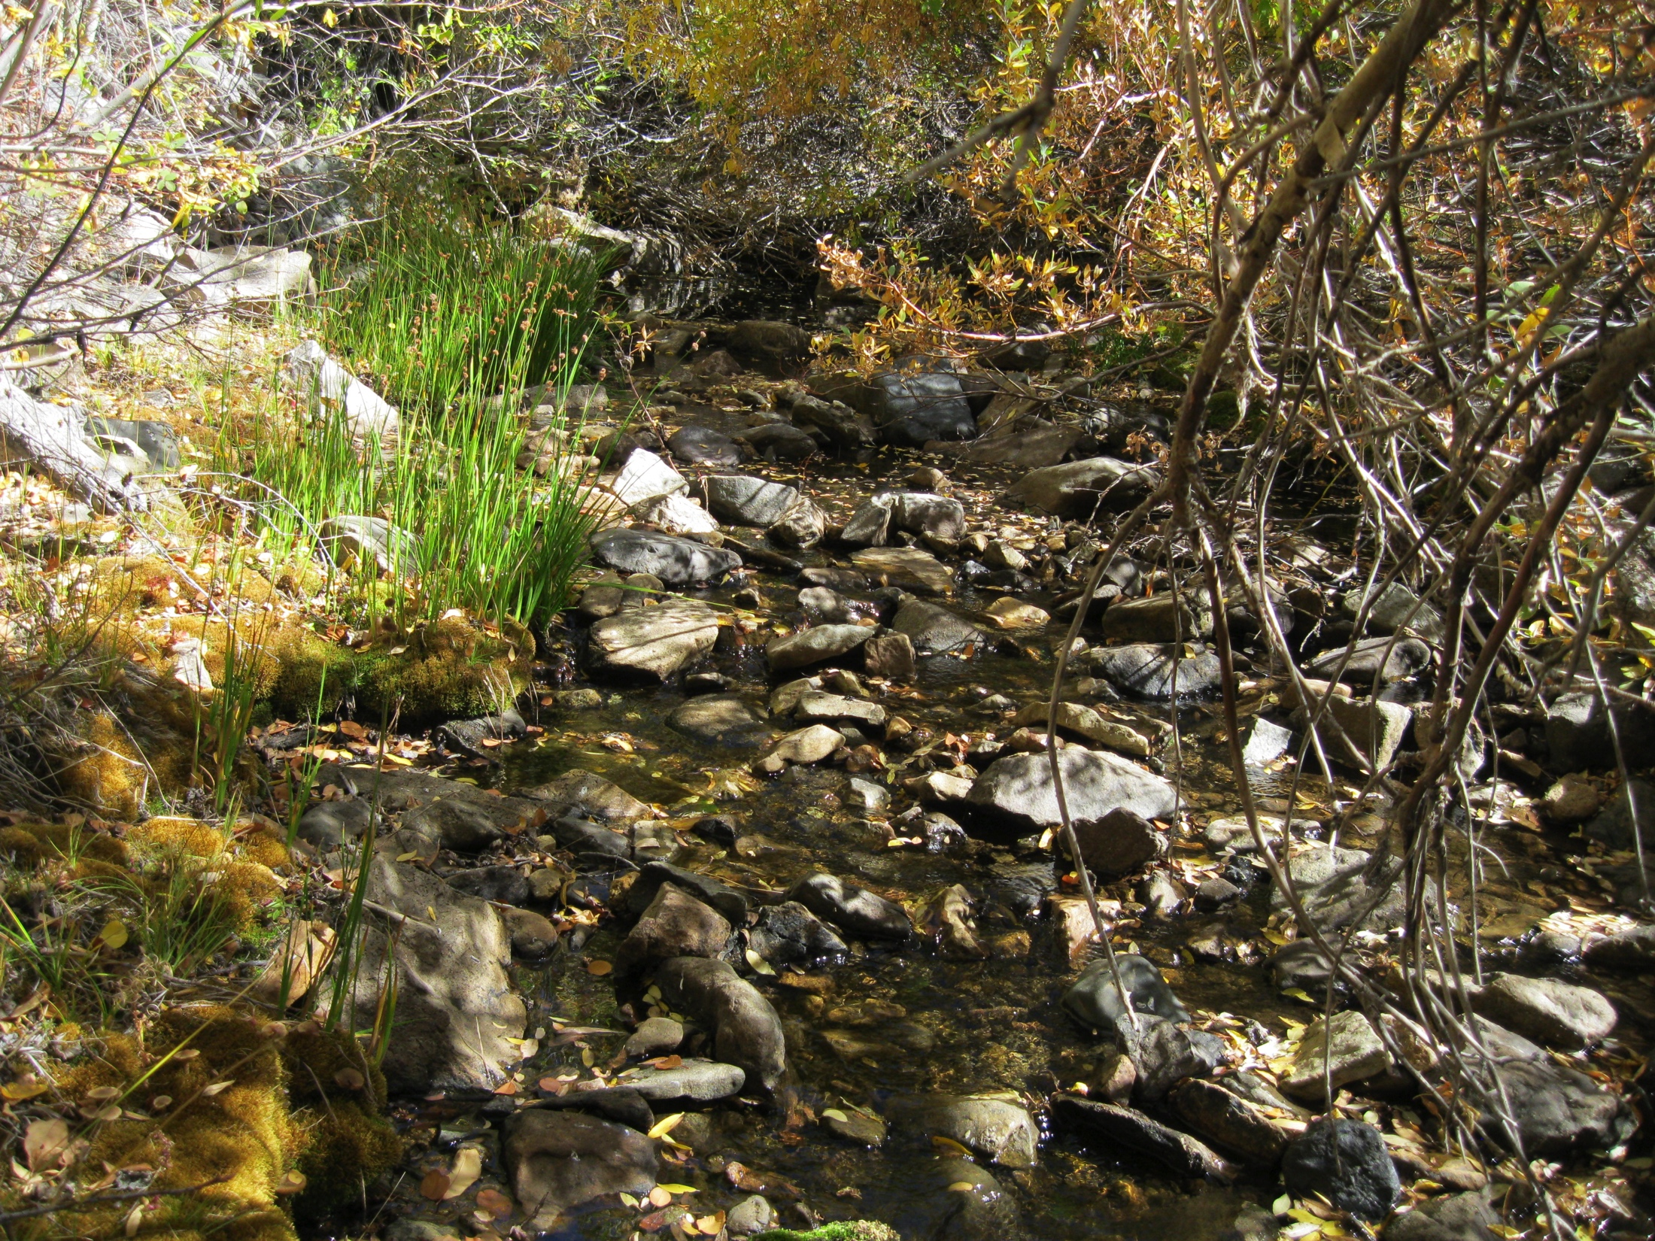

Slide 21
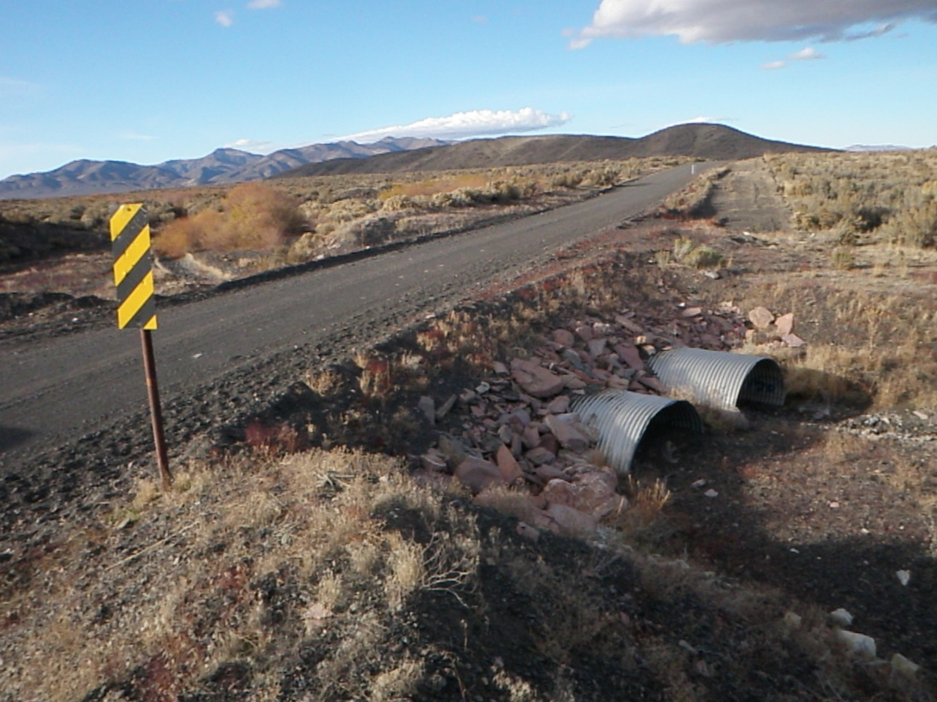
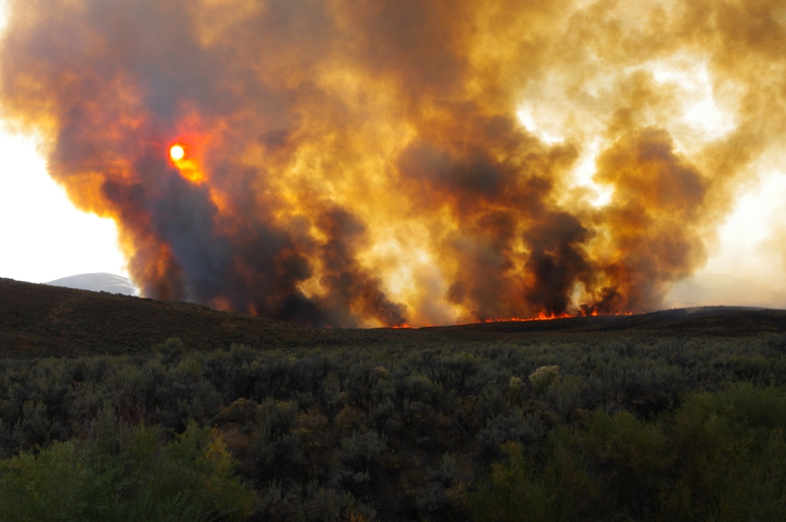
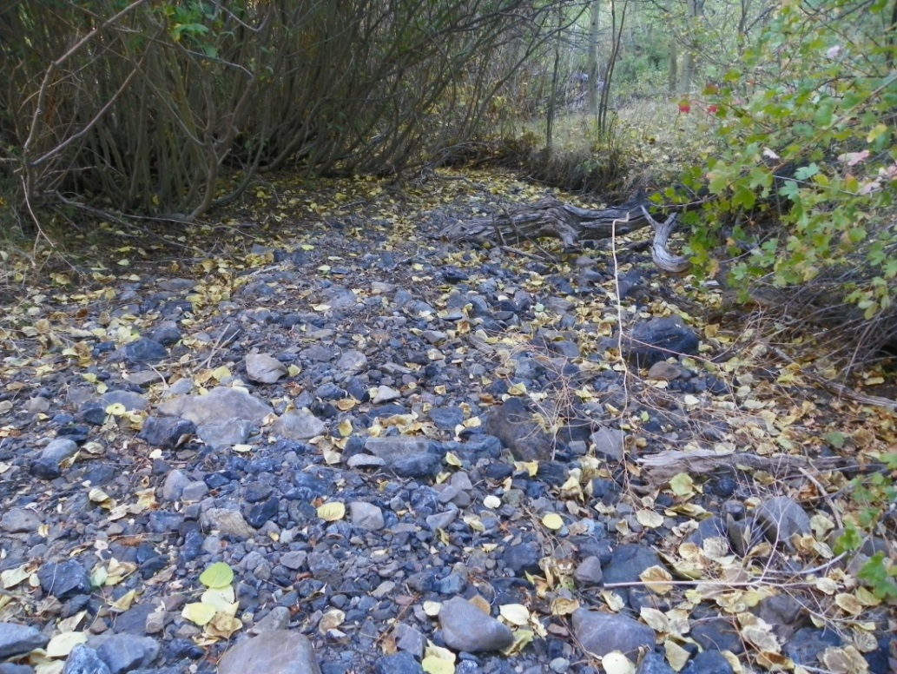
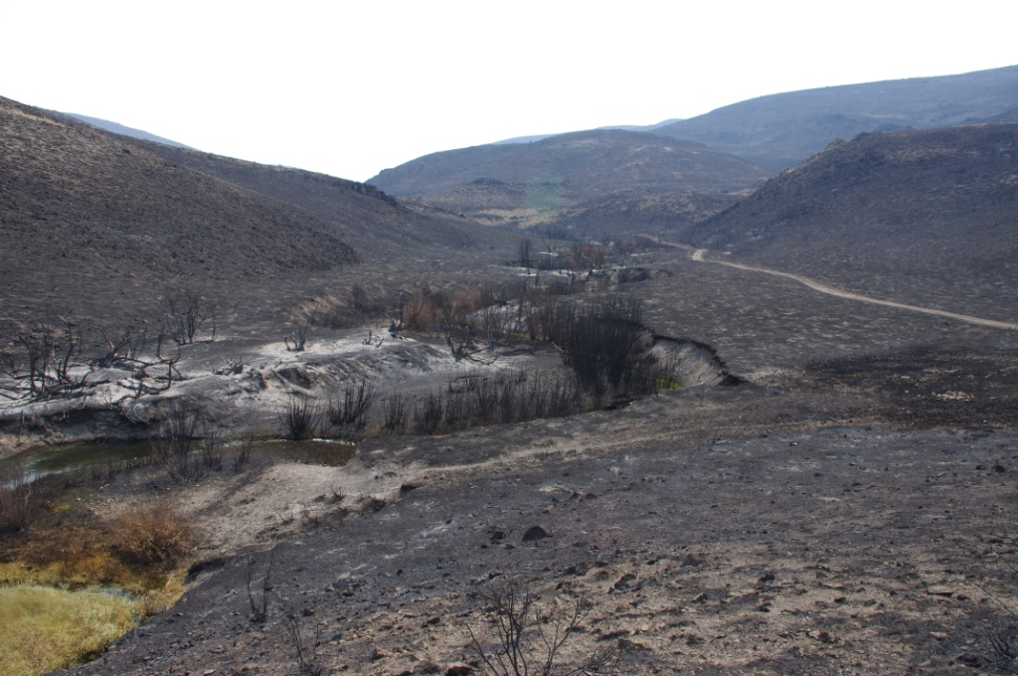

Slide 22
Building the fish database

Slide 23
Fish data organization
Population | 1992 | 1993 | 1994 | 1995 | 1996 | 1997 | 1998 | 1999 | 2000 | 2001 | 2002 | 2003 | 2004 | 2005 | 2006 | 2007 | 2008 | 2009 | 2010 | 2011 | 2012 | 2013
Abel
Andorno
Carville
Chimney
Coyote
Dixie
Draw
EMR
Foreman
Frazer
Gance_RdCny_Warm
Gennette
Hanks
Indian
LittleJack
Maggie
Mahogany_SummerCamp_Pole
Mohawk
MRBC
NFBattle
NFHR
NFurlong
Pearl
Question
Rock
SecondBoulder
SFIndian
SFLH_Pole_Snowstorm
Smith
T_Creek
Threemile
Tierney
ToeJam
Whitehorse_OR
Wildcat
Willow_Lewis_Nelson
Willow_OR
WMR_CmpDraw_Gaws

Slide 24
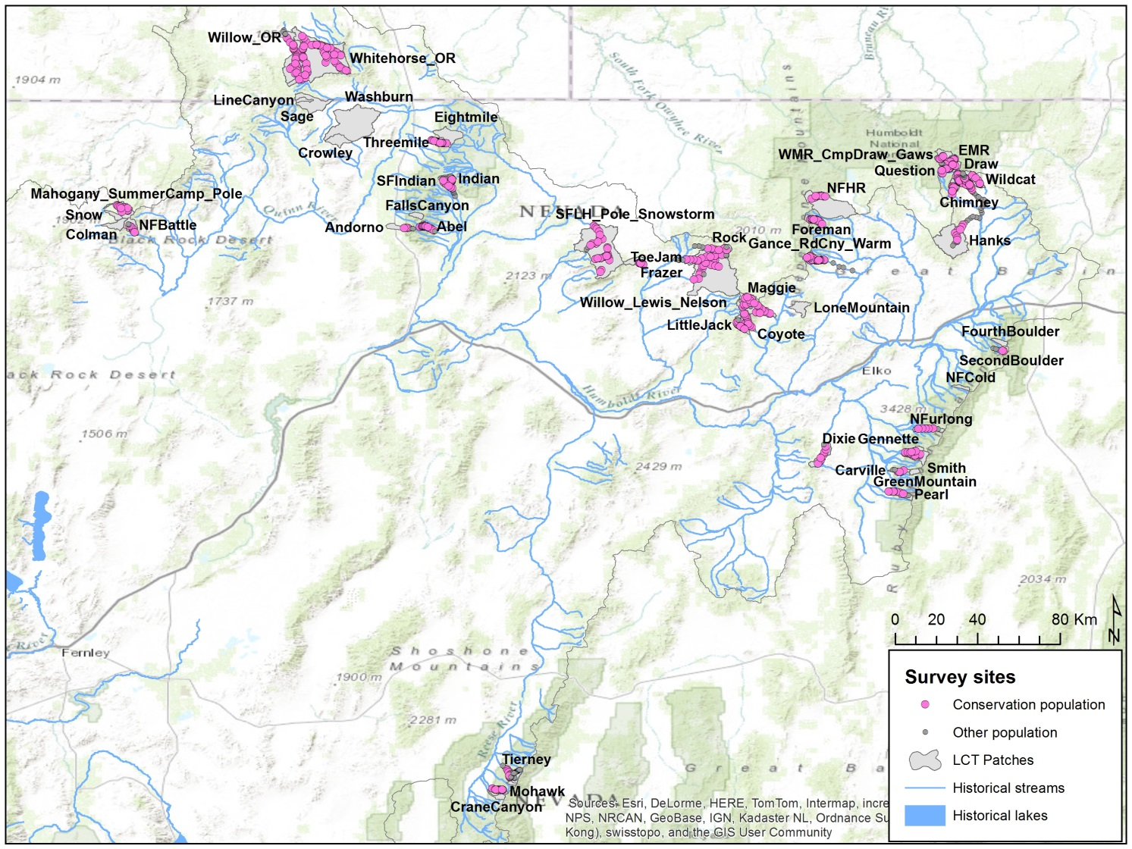
Fish data organization
OREGON
IDAHO
CALIFORNIA
NEVADA
52 populations of Lahontan cutthroat trout (LCT) with 852 sampling sites, 2,547 sampling events, and 23,757 individual fish collected.

Slide 25
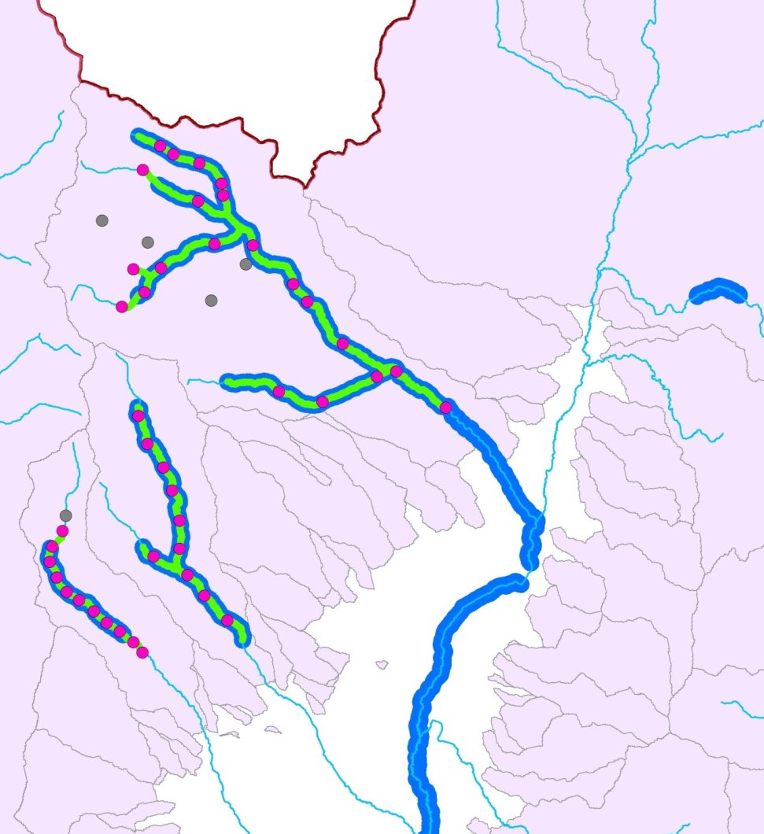
From counts to population estimates
Raw data: counts of fish in individual passes
Required: full population estimate for each year
We have developed an observation model and extrapolation procedures that preserve uncertainty

Slide 26
Basic observation model for 3-pass data
Can place covariates on detection (p)
Can combine with other, independent estimates of N

Slide 27
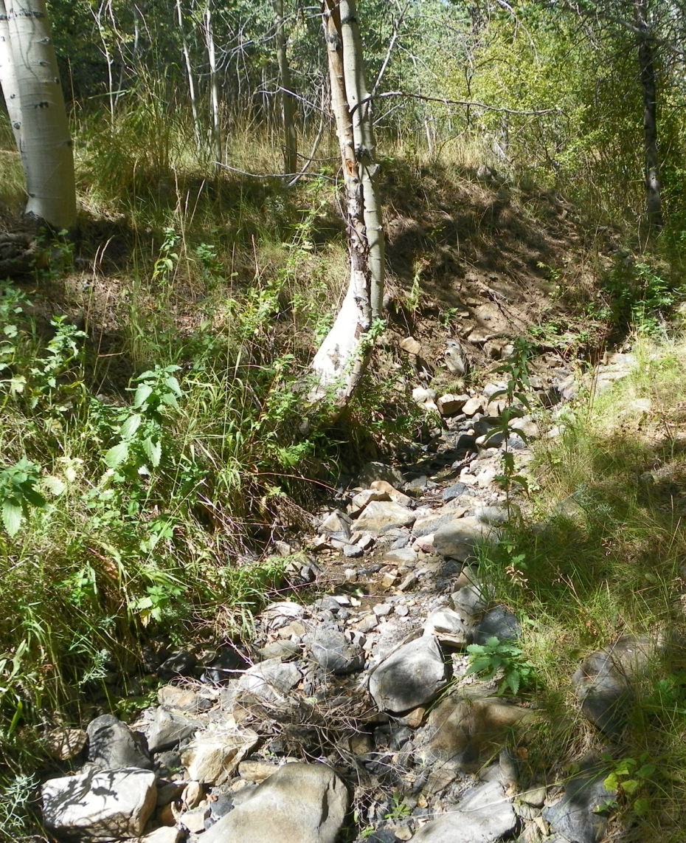
The problem of desiccation
Many streams are intermittently dry
There may be bias in sampling
Dunham et al. are building a desiccation model.

Slide 28
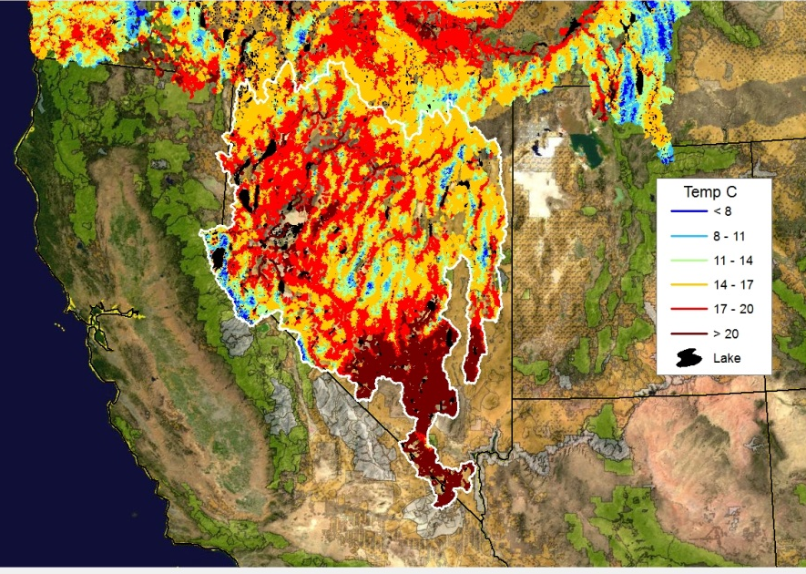
Covariates- stream temperature
Annual estimates of mean August stream temperature for every 1km stream segment
Current and future climate conditions

Slide 29
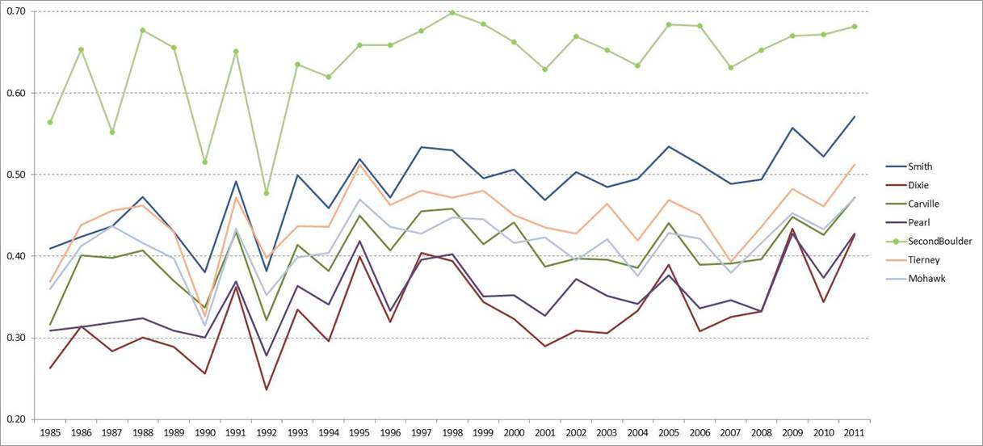
Covariates- NDVI
Riparian max NDVI from Landsat 5/7/8

Slide 30
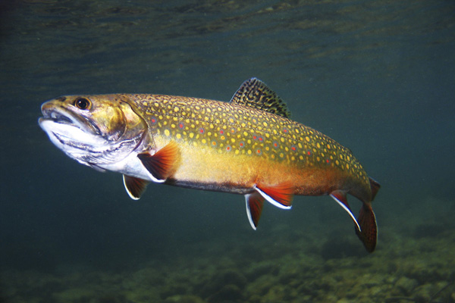
Covariates
Habitat size: +
Riparian NDVI, 1 year lag: +
Stream temperature: + (hmm)
Summer flow: +
Winter high flow: -
Winter high flow, 1 year lag: +
Brook trout: -

Slide 31
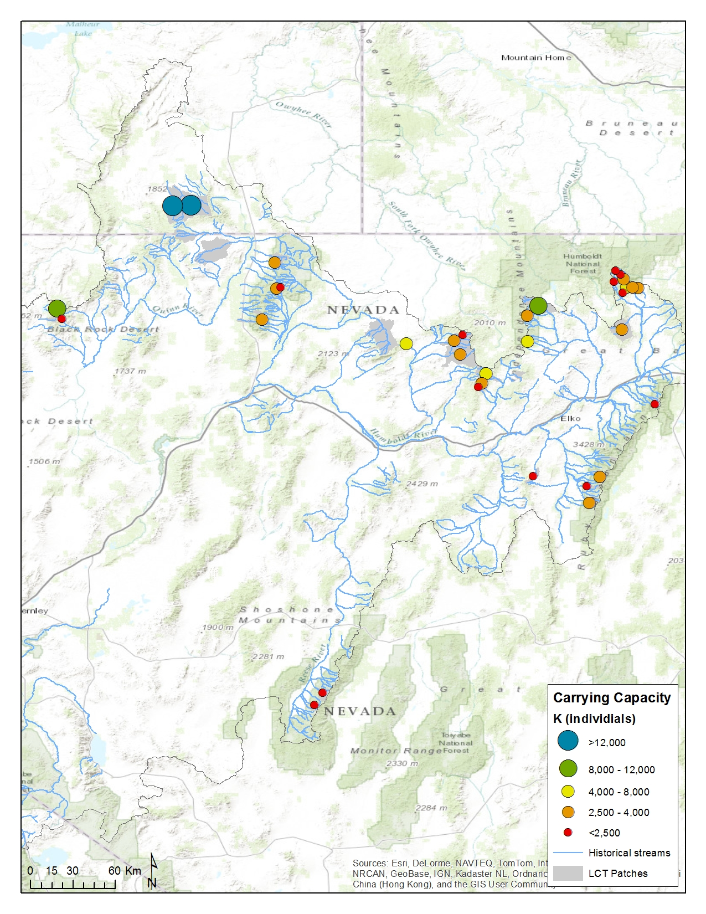
Results- K
K ranges from ~1500 (Indian Creek) to 65,000 (Whitehorse system). Most are <4000.
These may be biased high.

Slide 32
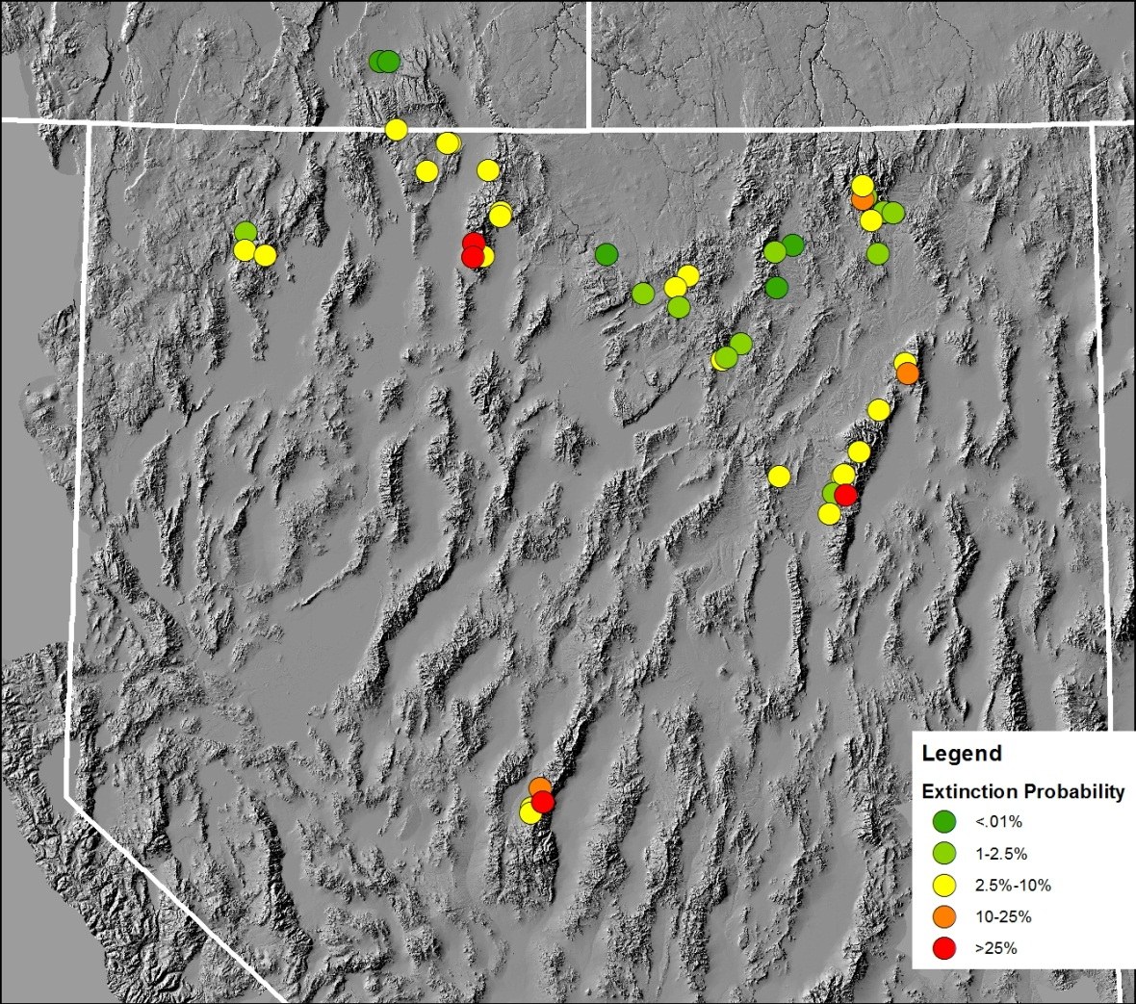
Results- Viability
20-year extinction probabilities range from <.1% to 52%

Slide 33
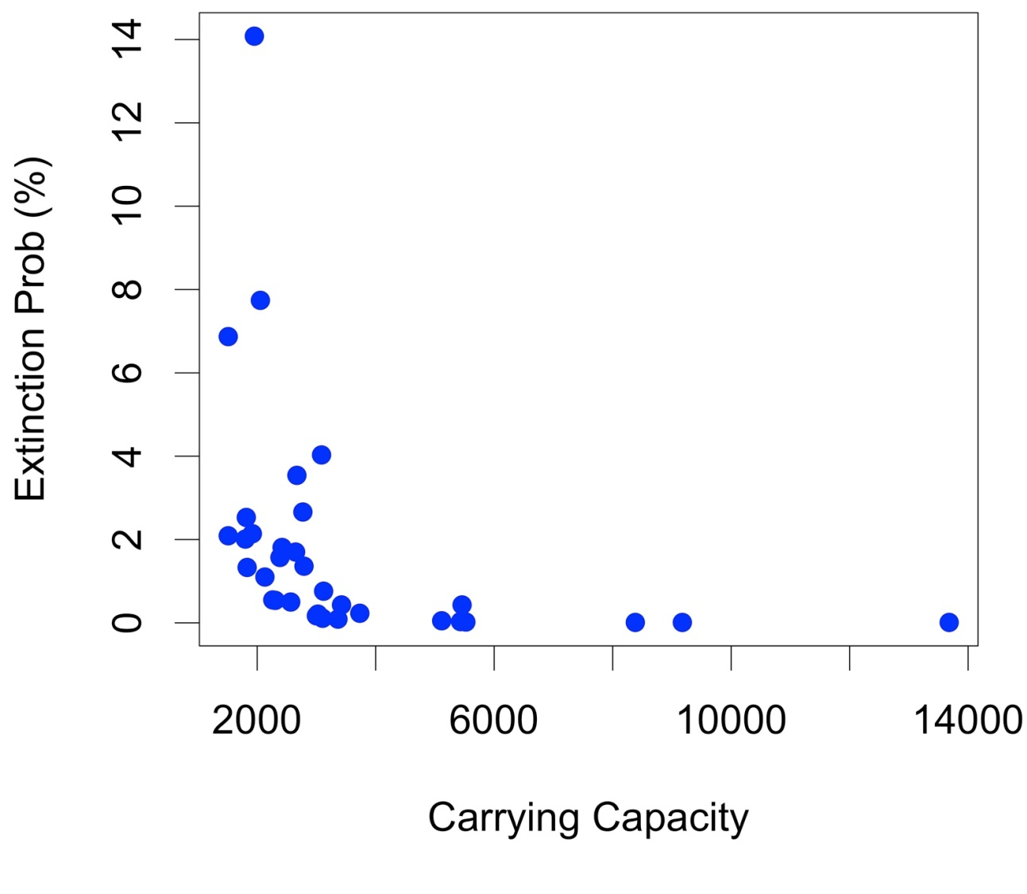
Results: Carrying Capacity vs Extinction

Slide 34
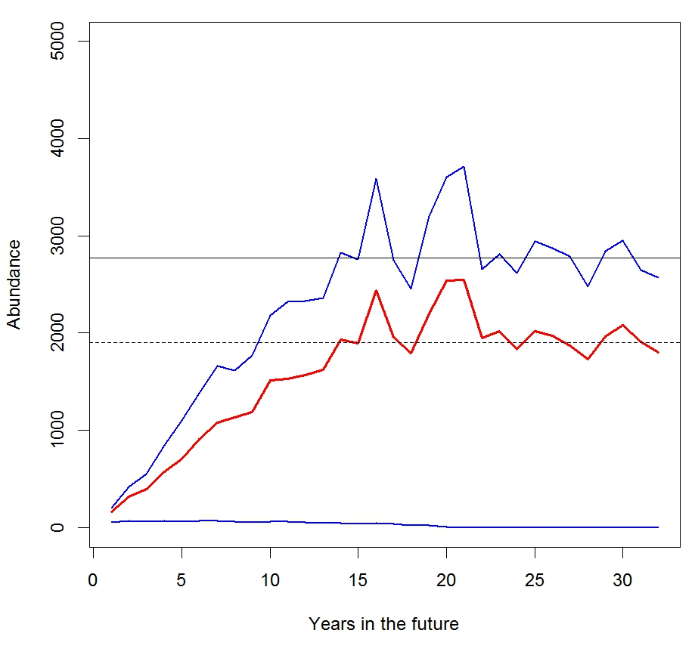
Results: Typical Forecast of N

Slide 35
Disseminating Outputs: PISCES Web Portal

Slide 36
Citizen science contributions

Slide 37
Alternatives: niche modeling

Slide 38
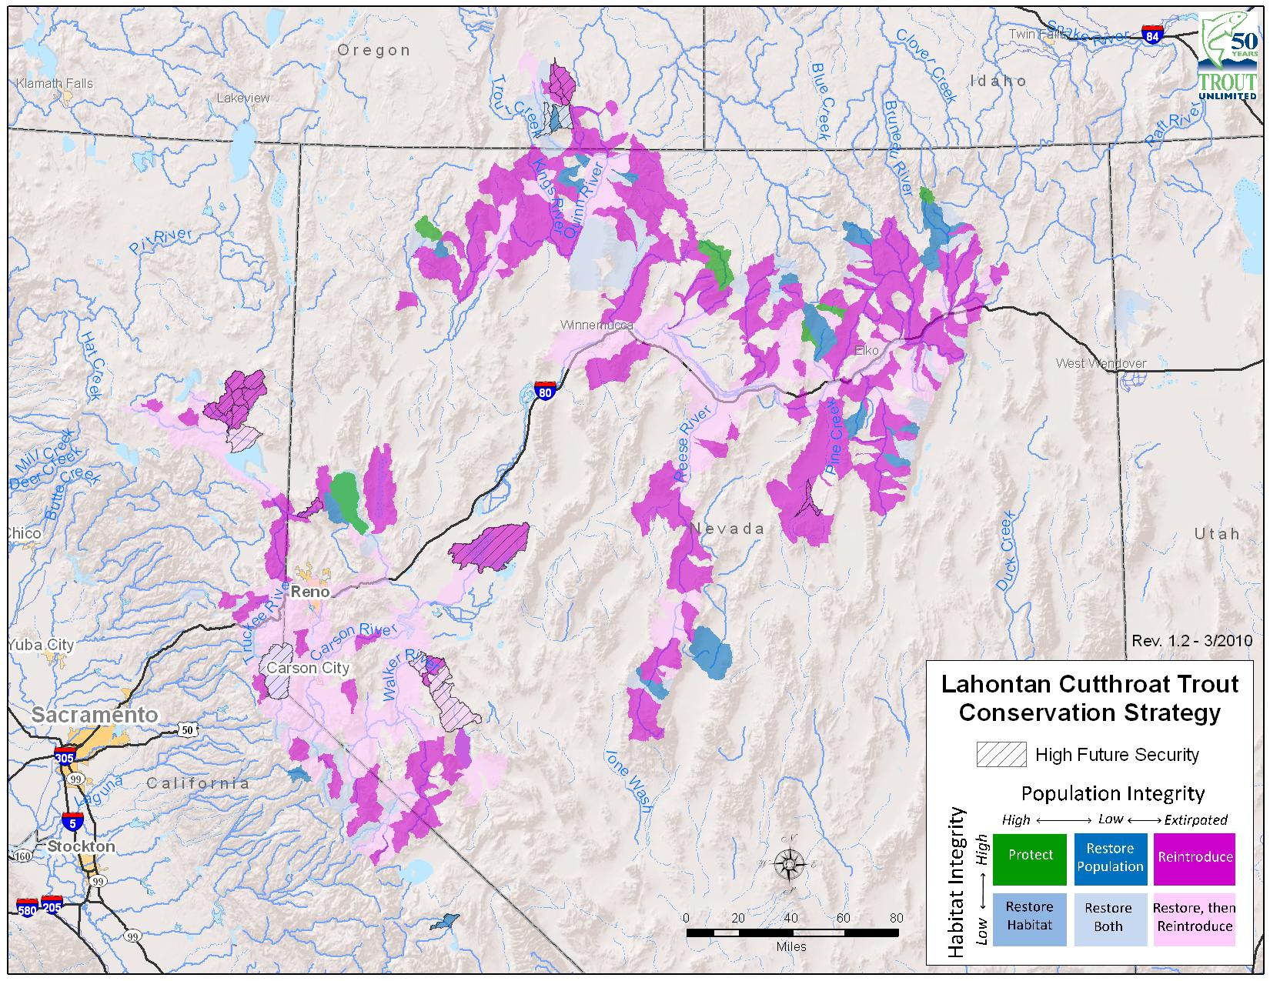
Connecting to population assessment
Conservation Portfolio

Slide 39
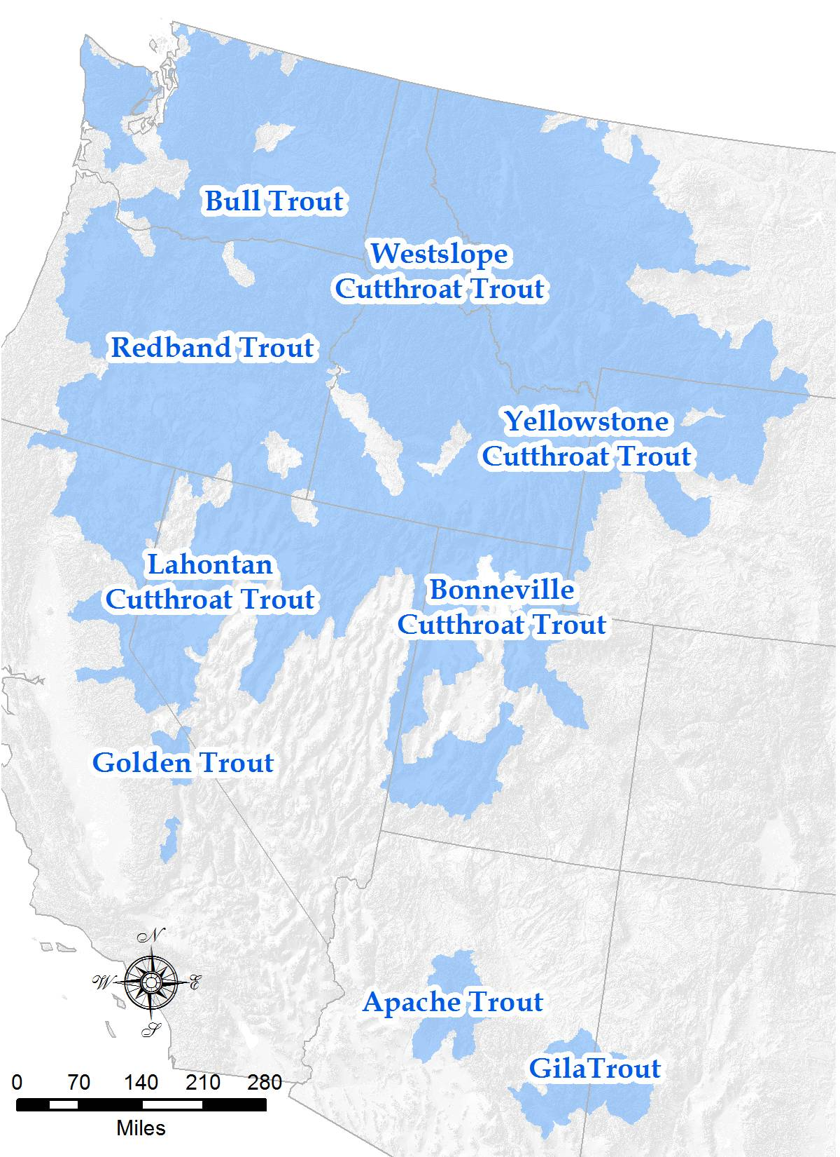
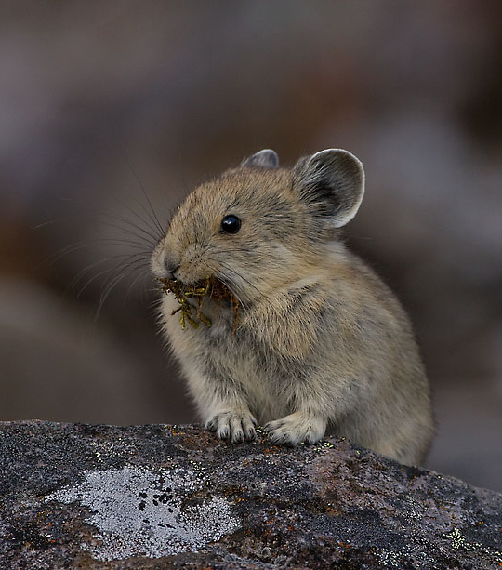
Expanding to other taxa

Slide 40
Next steps
Improved flow estimates
Climate scenario forecasts
Models with competition
Better integration with CDMetaPOP
Catastrophes

Slide 41
Acknowledgements: Funding
NASA grant number NNX14AC91G
Bureau of Land Management
Seattle City Light
Trout Unlimited
US FWS

